Slide 1
Explaining taxonomy roi:
Lessons from the jstor thesaurus
Taxonomy Boot Camp
November 14, 2016
Jabin White | VP of Content Management | ITHAKA/JSTOR | jabin.white@ithaka.org

Slide 2
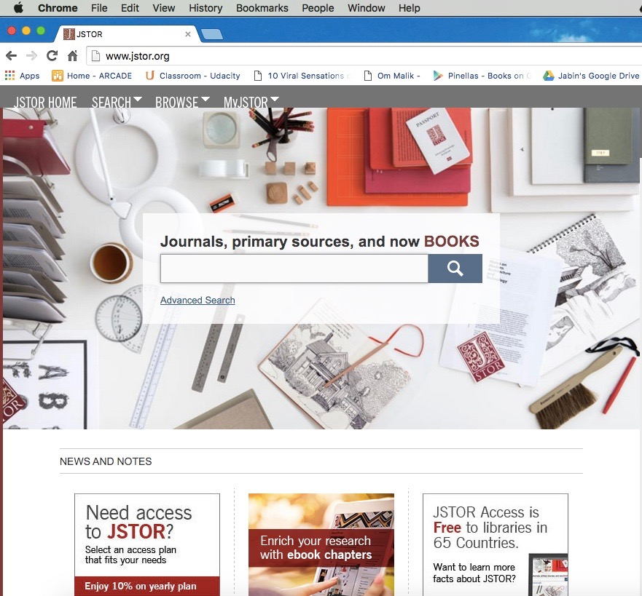
AGENDA
Introductions
First things first – the idea
Making the business case
Building the thesaurus
Setting up an infrastructure
Internal advocacy
Working with JSTOR Labs
Next Steps

Slide 3
introductions
20 years in publishing, most of them digital
Started as editorial assistant, learned SGML working on drug reference (makes me feel old)
Stops at Elsevier, Silverchair, and Wolters Kluwer before ITHAKA
Big believer in effective use of technology for providing workflow efficiencies, but try not to “fall in love” with technologies
Vice President of Content Management, responsible for production for JSTOR and Portico, as well as the systems that support production

Slide 4
ITHAKA is a not-for-profit organization that helps the academic community use digital technologies to preserve the scholarly record and to advance research and teaching in sustainable ways.
JSTOR is a digital library of academic journals, books, and primary sources.
Ithaka S+R is a research and consulting service that helps academic, cultural, and publishing communities thrive in the digital environment.
Portico is a preservation service for digital publications, including electronic journals, books, and historical collections.

Slide 5
JSTOR FACTS AND FIGURES (Archive)
 | 2015
Total Participating Institutions (Archival Journals) | 9,861
Countries | 175
Archival Journals Online | 2,389
Archival Articles Online | 10,412,773
Content Accesses | 135,848,378
Search | 90,209,422
Browse | 36,765,928
Inbound Links from Google | 102,911998
Successful Google links | 32,769778
Google Links Denied | 70,142,220

Slide 6
JSTOR FACTS AND FIGURES (Other)
 | 2015
Current Journals Online | 332
Current Journal Publishers | 81
eBook Publishers | 88
eBooks Online | 40,000
Pamphlets | 25,976
Grey Literature, Art objects and other Documents | 250,000
Plant Type Specimens | 2,600,000

Slide 7
202,000+
Facebook fans
32,000+
Twitter followers
5,300,000+
MyJSTOR Accounts

Slide 8
First things first: the idea

Slide 9
Why?
We believed in the power of semantic indexing to drive more precise search results and other benefits to delight our users
A humanities/social sciences based thesaurus that matched our content set did not exist
Despite heavy advances in STM (Science, Technical & Medical) publishing, the H/SS sector had not done much with semantics
Opportunity, but also a decent amount of trepidation

Slide 10
Making the business case

Slide 11
Business case
The case was really about answering three questions:
Was there value to semantic indexing for JSTOR?
Was our chosen path the right one?
Would we recoup our investment (note that this is NOT a budget question exclusively)

Slide 12
1. SEMANTIC VALUE?
A pretty strong case for value
Again, we have >60 million pages, >10 million articles, and >2,000 journal titles on line, plus >40k books
Ability to link different content types – journal articles, books, primary sources, etc. – is a powerful tool and will help users find content more easily
Serendipitous discovery of content
Ability to send richer metadata to web-scale discovery services – people are finding content in different ways than they did in the past

Slide 13
2. Were we on the right path?
Options for approach were either automated (good scale, but not precise) or manual (no scale, expensive, but very accurate)
Automated tools seemed better suited for when there was a “right” answer, not shades of meaning
But a Humanities/Social Sciences thesaurus did not exist
MAIstro software offered best of both worlds – Rulesbuilder concept allows you to write rules, index content, tweak rules, and run again

Slide 14
3. Recoup the investment?
Again, not a financial argument exclusively (we are a not-for-profit and mission-based organization)**
We measure KPIs (Key Performance Indicators) about usage. Would this lead to more users downloading and getting access to more content – we thought YES
Also an inherent “good” for the community of scholarly communications, to create something that did not exist before
** Crude financial formula would be value of increased usage (tough to measure delight) over investment in thesaurus

Slide 15
Building the thesaurus

Slide 16
What we did
Working with Access Innovations (combination of technology/editorial)
Licensed 17 different vocabularies covering topics from history to business
Merged lists, sorted terms hierarchically and removed duplicates
Some sources:
ASIS&T MeSH
CABI NASA
ERIC NICEM
EuroVoc Philosopher’s Index
Getty Art and Architecture

Slide 17
Details at launch
57,223 Preferred Terms
41,876 Non-Preferred Terms
18 top-level terms (roughly akin to the top of the JSTOR “browse” tree
18,346 terms with [at least one] Related Term
20,922 terms with [at least one] Non-Preferred Term
103,380 Rules (applied by Rulesbuilder files)
5,488 conditional rules
Notes:
As of last week - 48,644 terms; 92,016 rules

Slide 18
Internal advocacy

Slide 19
Internal advocacy
Selling the concept of semantic indexing, and advocating for our approach
Working with technology staff on the benefits of thesaurus
Working with User Experience staff on best ways to expose thesaurus value to end users
Partnering with marketing and communications to properly message benefits of thesaurus

Slide 20
An interesting mix
We were essentially “selling” two things:
The benefits of semantic indexing in general
The benefits of our approach and usefulness to JSTOR users
This continues to this day
It’s an interesting combination of education and sales
Notes:
Combination of Willy Loman and Aristotle

Slide 21
Setting up an infrastructure

Slide 22
Building blocks for maintenance
Appointing a thesaurus owner (the ceremony was lovely)
Training existing Metadata Librarian staff on concepts of working with thesaurus (including adding/purging terms, building rules, and working with SMEs
Recruiting and supporting Subject Matter Experts (SME’s)
Working with technology staff on support of MAIstro software and semantic search

Slide 23
Jstor Labs
Test and (hopefully) prove value of JTHES by working with JSTOR Labs team
Sustainability site, Understanding Shakespeare, JSTOR Snap, Classroom Readings
http://labs.jstor.org

Slide 26
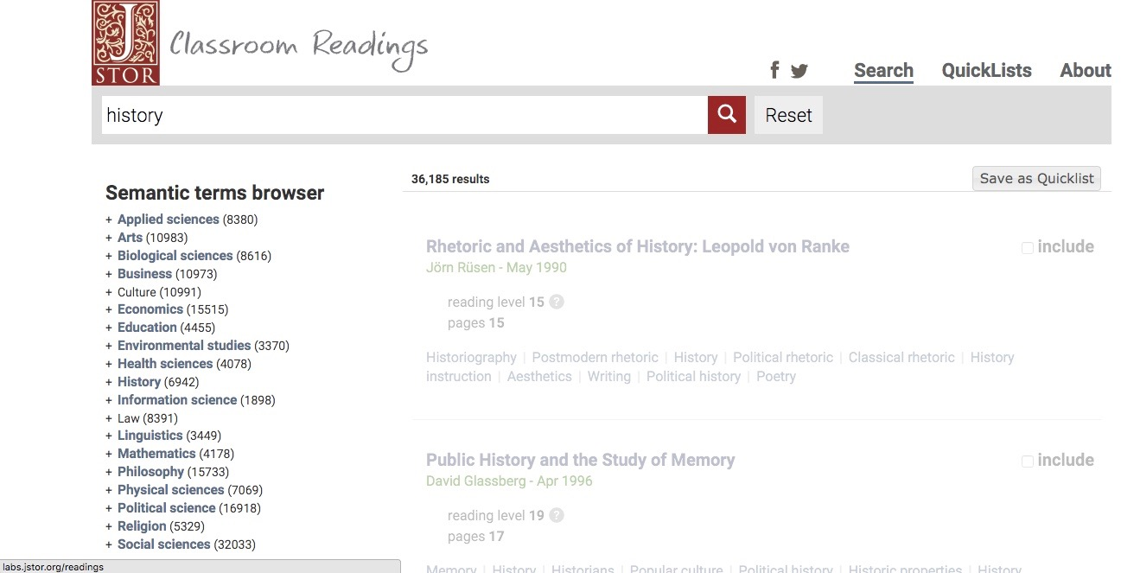

Slide 27
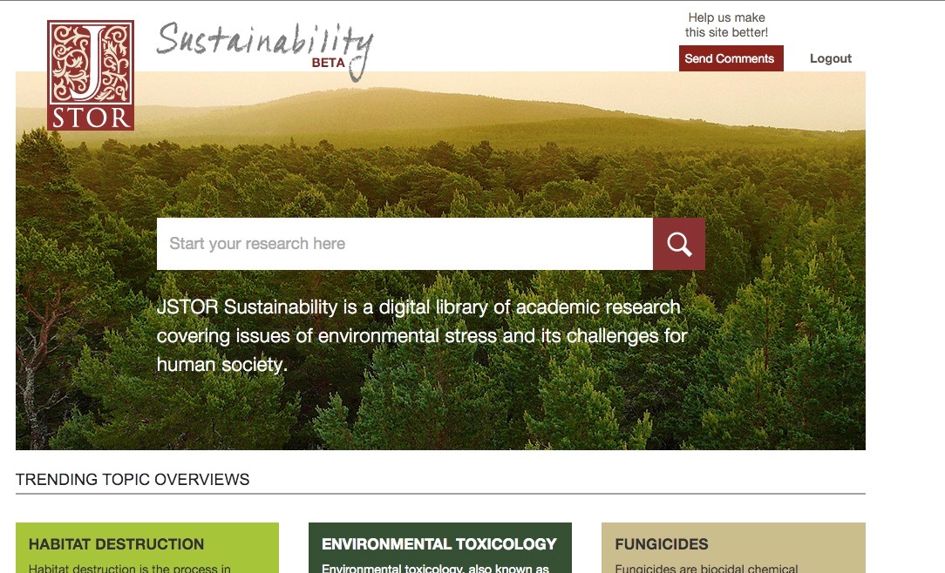

Slide 28
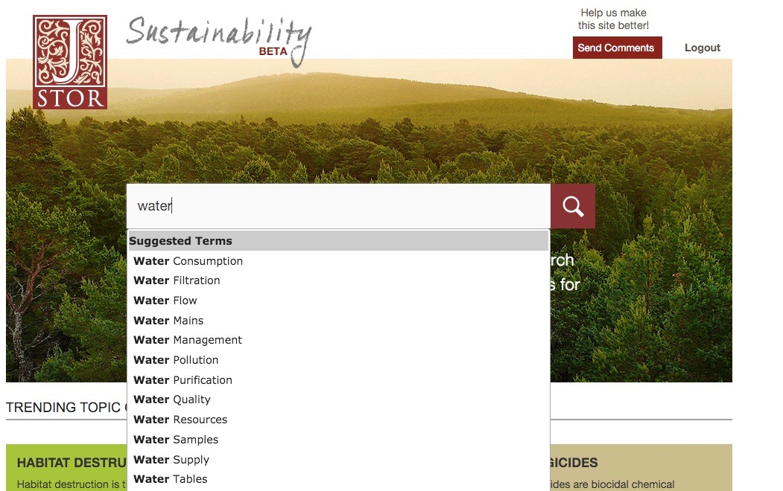

Slide 29
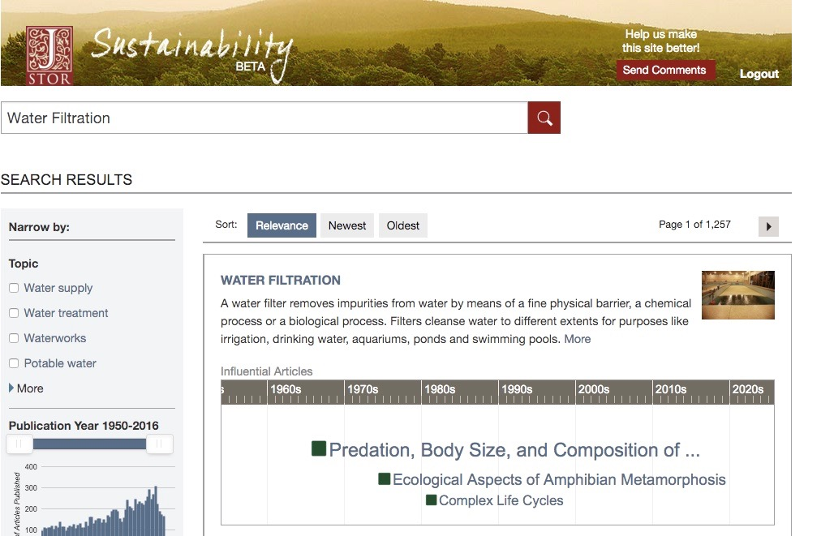

Slide 30
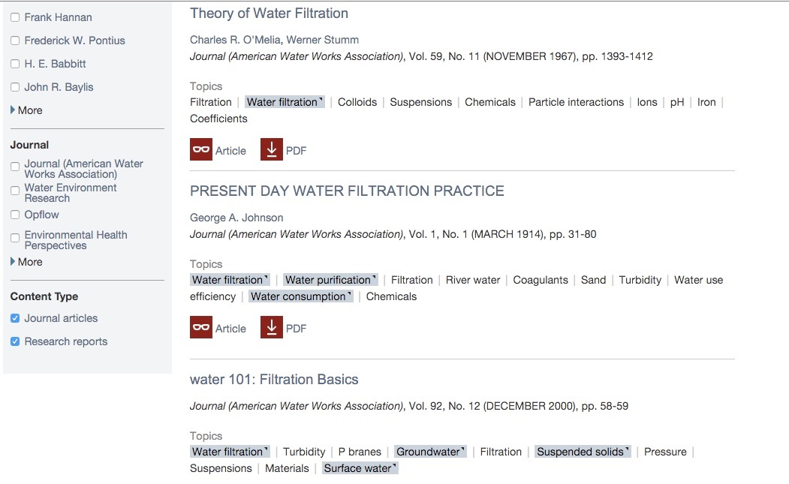

Slide 32
Next steps
Add thesaurus terms to JSTOR search index
Continue work with JSTOR Labs to investigate value for users
Work with UX and platform teams on exposing thesaurus benefits through UI features; A/B test with users
Increase SME participation in certain subject areas
Add semantic terms to metadata feeds to web-scale discovery services

Slide 33
THANK YOU
Jabin White
VP of Content Management
ITHAKA/JSTOR
jabin.white@ithaka.org

