Slide 1
Digital Workflows and Metadata
Jabin White
Vice President, Content Management
ITHAKA/JSTOR
SSP Pre-Conference Seminar
May 19, 2021

Slide 3
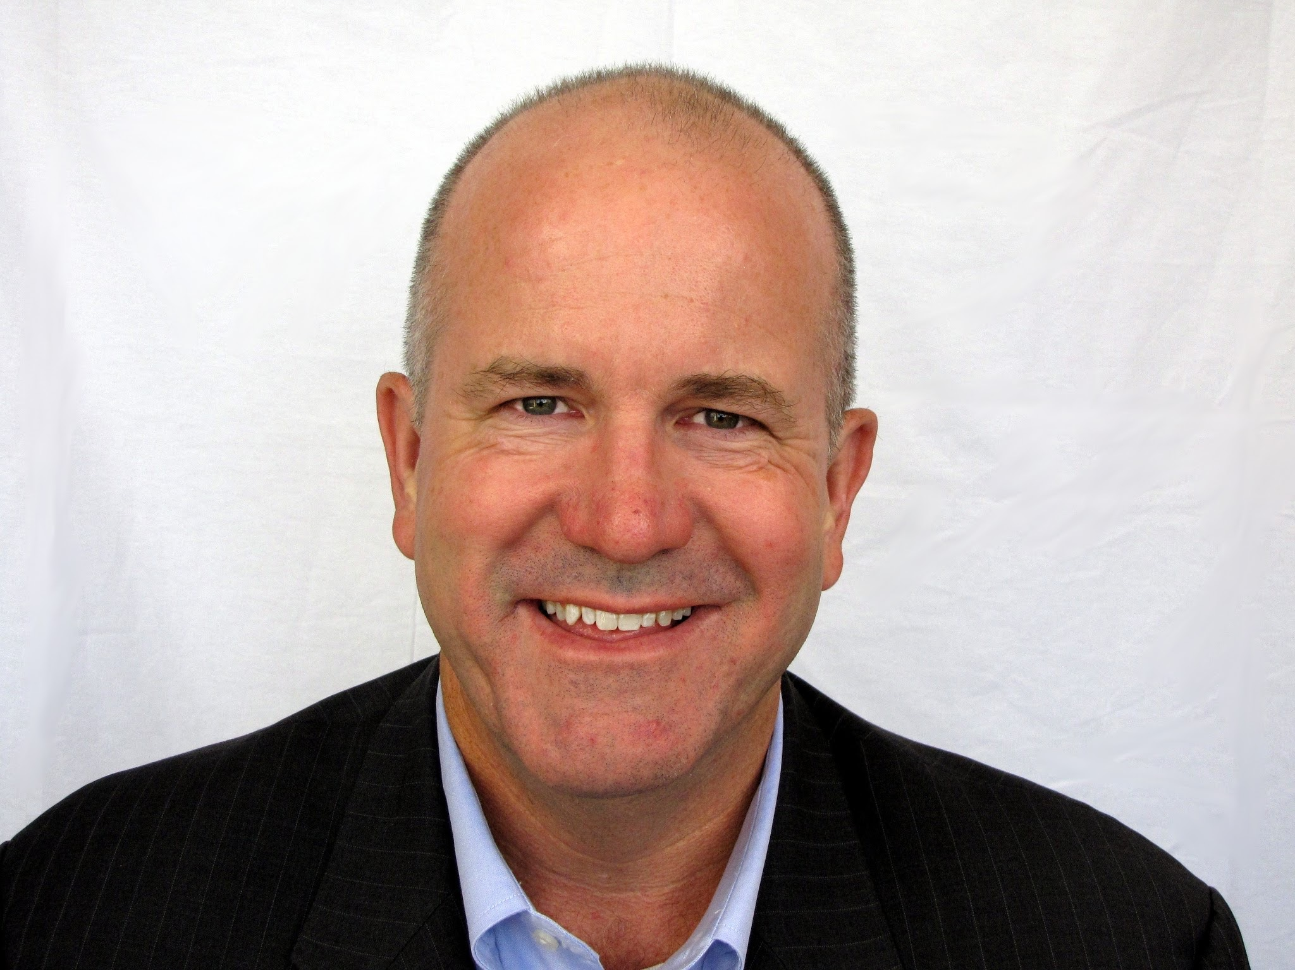
But first, who am I?
VP of Content Management at ITHAKA since 2010
Handle content and CM systems for JSTOR and Portico
Before that, medical publishing (Elsevier, Wolters-Kluwer, Silverchair, and Mosby Year-Book)
Learned SGML (yes, I’m that old) in 1995 working on Mosby’s GenRx, a drug reference

Slide 4
Workflows and Metadata – What I’ll cover
Workflow options
What are your publishing goals?
Metadata
What are the different types,
and what are they used for?
Final thoughts

Slide 5
Workflow considerations
Authoring Tools
Manuscript submission/tracking & Peer Review
Copyediting/Developmental Editing/page composition
XML first or conversion?
Digital preparation/enhancement
Vendor/Partners

Slide 6
Authoring Tools
Depends on control
Word, Google docs, etc., might be preferred by authors, and you might not have a choice
The more you can get the authors to participate in tagging, the better, but…
I always wanted to get authors to tag their content, but I wanted to look like Tom Cruise and act in movies, too
Journals have the advantage of peer review process, where you can get authors into systems sooner
Books can be tricky, and might require more DE work “off system”

Slide 7
Manuscript Submission/Tracking
Mature market (Editorial Manager, ScholarOne, etc.)
Peer Review is varied and dependent on goals of journal
Generally, rejecting earlier saves $$$**, so finding the right balance is key
** Kent Anderson’s Scholarly Kitchen Post

Slide 8
Copyediting/DE/Page Composition
In-house or vendor/partner?
Journals vs. Books
Journal articles generally stand alone; books come in chapters that must potentially be judged along with other chapters
Page composition can mess up digital plans – be careful
We are well past the point of making pretty pages and then converting for digital
Vendor/partners know how to do page composition with standard markup – why re-invent the wheel?

Slide 9
XML first or conversion?
Trust me, you are going to want a neutral format, but when?
Costs, flexibility, and your publishing goals
Vendor/partners can help with this
Listen to our next speaker (Bill) on standards
You would have to make a pretty solid case to NOT use anything other than JATS (for journals) and BITS (for books) as tagging standards

Slide 10
Digital Preparation and Enhancement
What are your intended platforms/audiences for this content?
Do you have the right metadata for those platforms?
The web, search engines, and discovery services all play a role in how users find/access your content
The earlier you think about this in the workflow, the better
More on this in metadata section

Slide 11
Vendor/Partners
At what stage in the workflow should you rely on a vendor/partner?
Generally speaking, vendor/partners will be cheaper, but the more standardized you are, the better…
Great maturation in this market in the last decade
Consistent, predictable paths of work can keep costs manageable

Slide 12
Metadata
Different kinds of metadata – Structural, Administrative, and Descriptive
What does it mean to produce “good metadata?” (the answer may surprise you…)
My definition of “good metadata” may not be the same as your definition, and that’s ok, but default to standard best practices

Slide 13
Structural Metadata
Examples: Page numbers, chapters, TOCs, Index, etc.
How is this thing organized?

Slide 14
Administrative Metadata
Examples: DOIs, ORCID, cc licenses
Rights, preservation, and technical stuff
For both structural and administrative especially, use standards!

Slide 15
Descriptive Metadata (my personal fave)
Examples: Title, Author(s), Keywords, semantic markup
This is where you can get a little crazy
Semantic metadata lets you ”describe” the content and can increase discoverability
This article is about ”the Battle of Hastings,” or this chapter is on “Shakespeare’s sonnets”

Slide 16
Descriptive Metadata (my personal fave)
If you want your content to stand out, invest here
Lean on standards for the first two, “too many” standards in this space
Everyone’s semantic layer is different, as they are rightly based on specific subject areas of content
Leverage SMEs, but build, borrow, or partner to describe your content appropriately; then SHARE IT with discovery services and search engines

Slide 17
Metadata Thoughts
Metadata is “having a moment”
It used to be a thing you did in addition to content; you could now argue it is *more* important than content in some cases
What good is content if it can’t be found, or it can’t be accessed?
Thinking about this should happen early in the process, not later, and it is NOT exclusive to production

Slide 18
Final Thoughts
Lots of differences between journals and books, types of publishers, and author expectations, but some truisms
*You* are the expert on what works best for your workflows and metadata practices
There is NO SHAME in relying on the experience and knowledge of vendor/partners
Standards are your BFF (shameless plug for Bill’s presentation next)

Slide 19
Thank you
Jabin White
Vice President, Content Management
ITHAKA
jabin.white@ithaka.org

